Slide 1

MUSTAFA IRFAN (121) (LEADER):
BSE-23F-121:
DEPARTMENT OF SOFTWARE ENGINEERING:
DATABASE:
TEACHER: AQSA UMAR:
ABDUL SAEED SHEIKH:
BSE-23F-138:

Slide 2
Welcome to our presentation on mastering DATABASES!

Slide 3
What are Databases?
Database:
A database is an organized collection of data stored in a computer system and usually controlled by a database management system (DBMS).

Slide 4
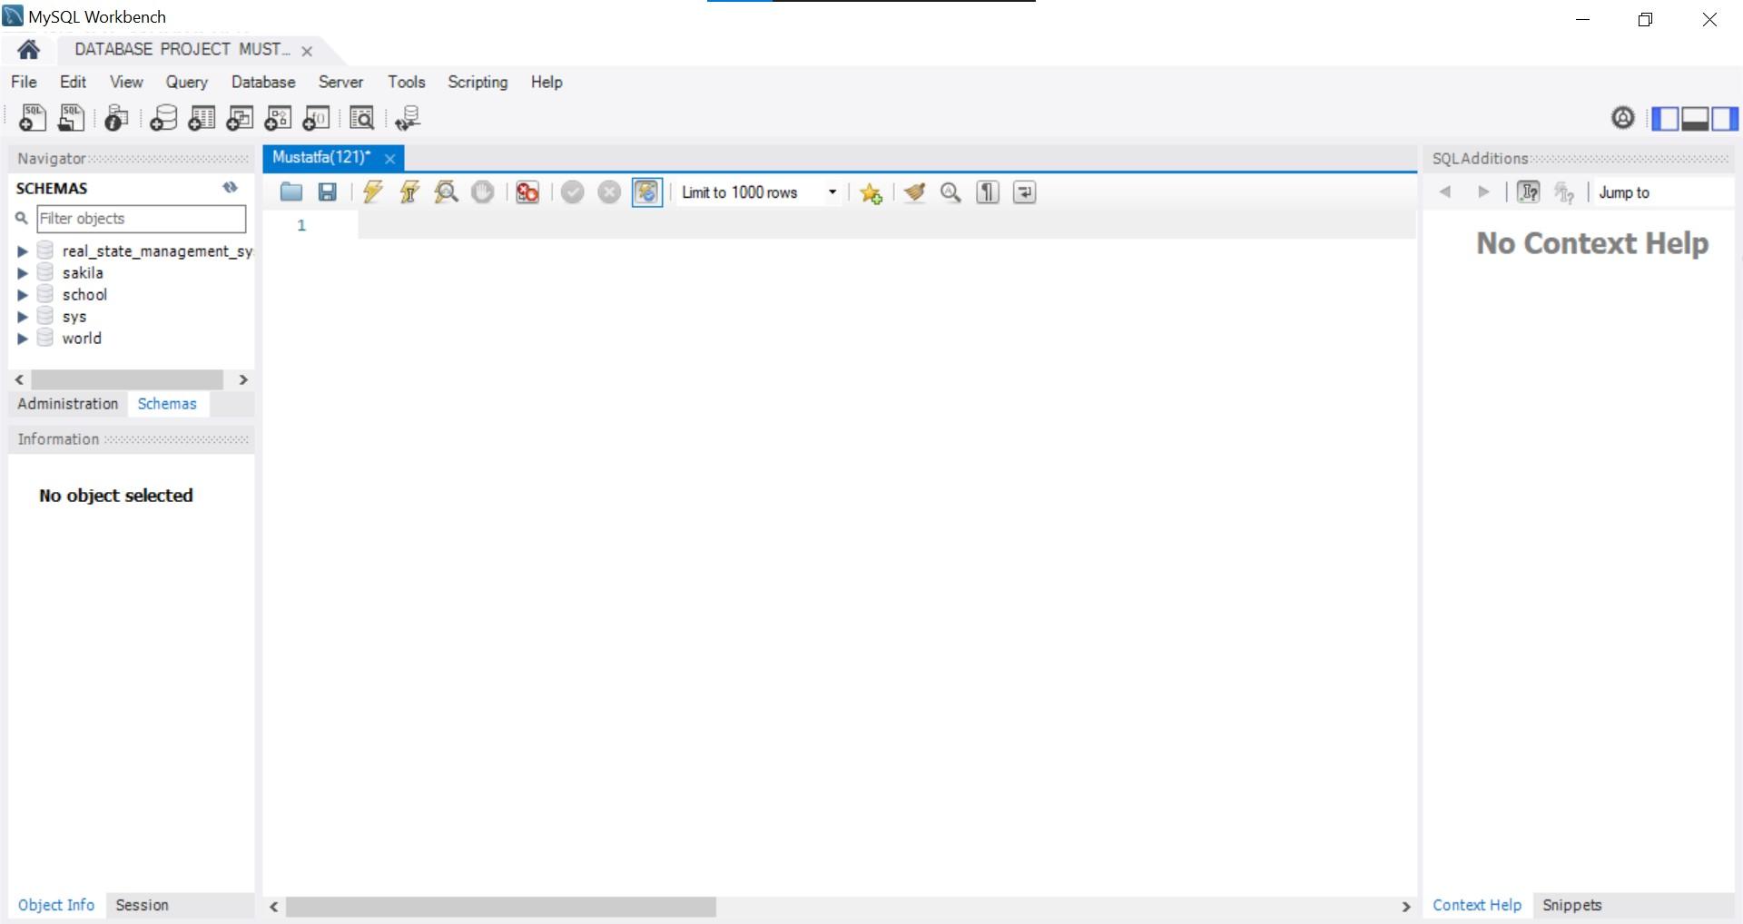
MySQL INTERFACE:

Slide 5
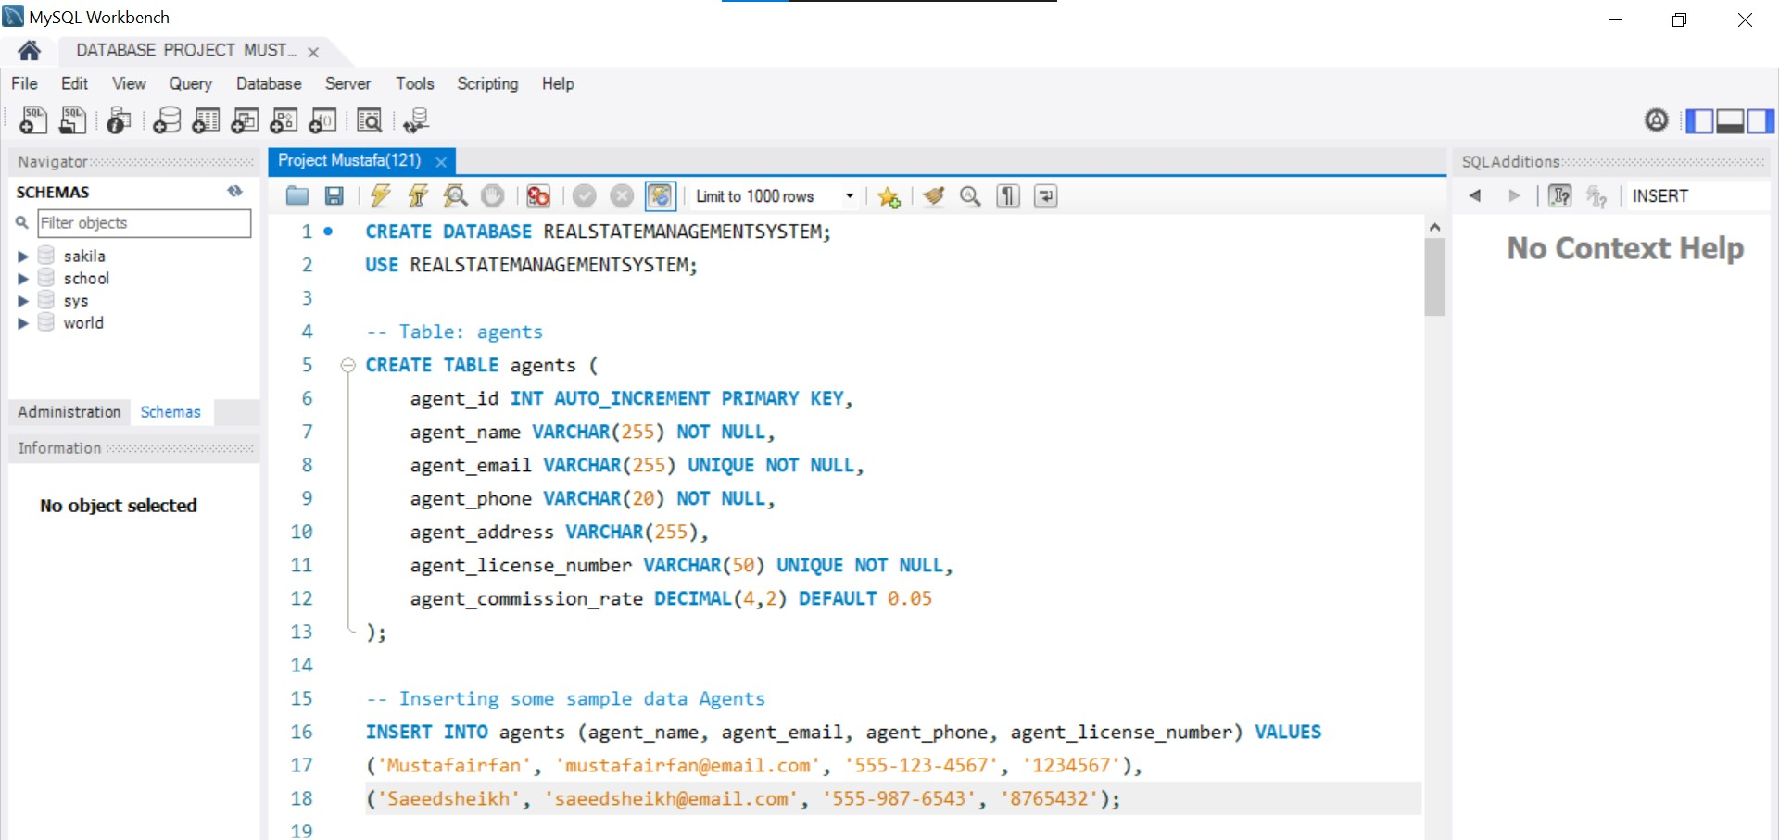
TABLES:

Slide 6
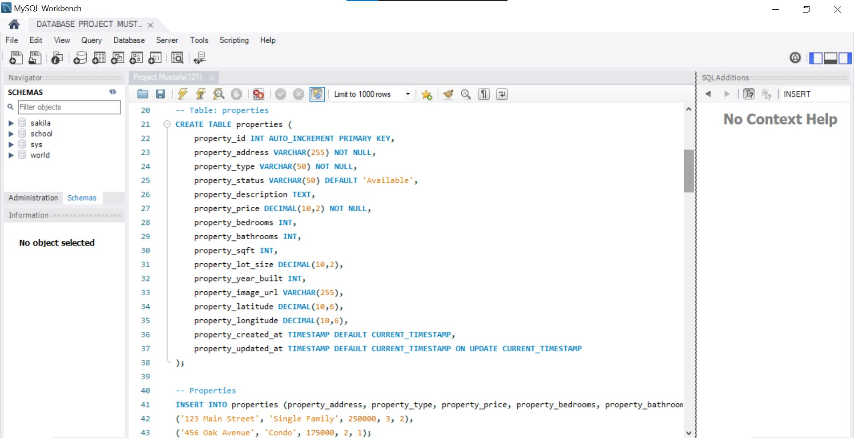

Slide 7
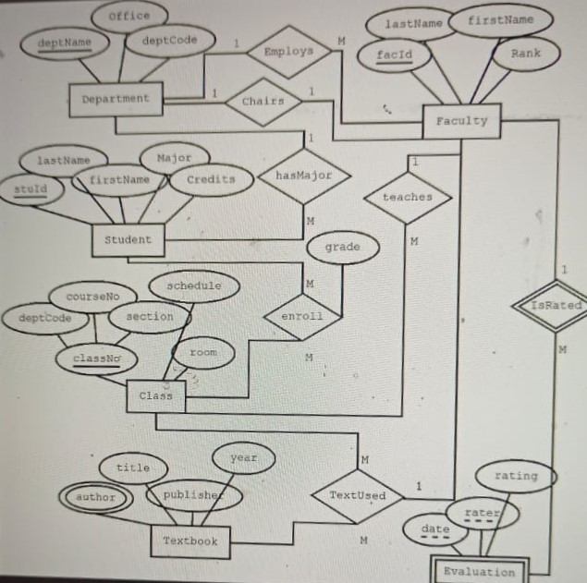
EER DIAGRAM:

Slide 8
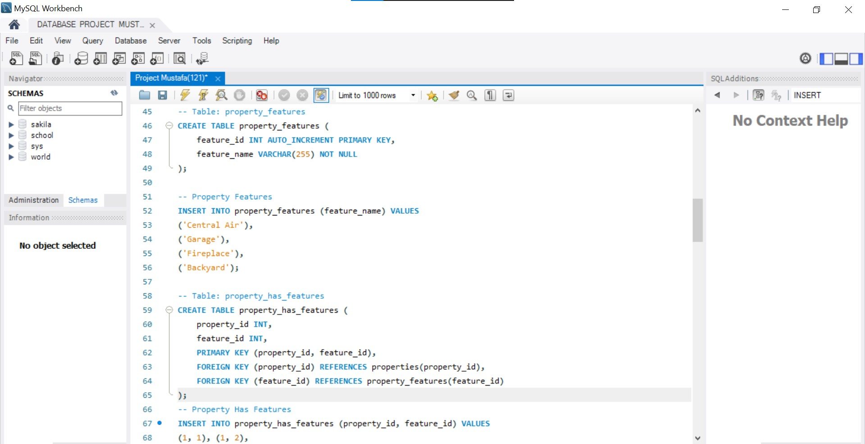

Slide 9
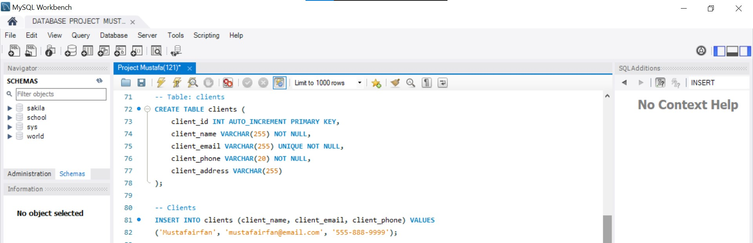

Slide 10
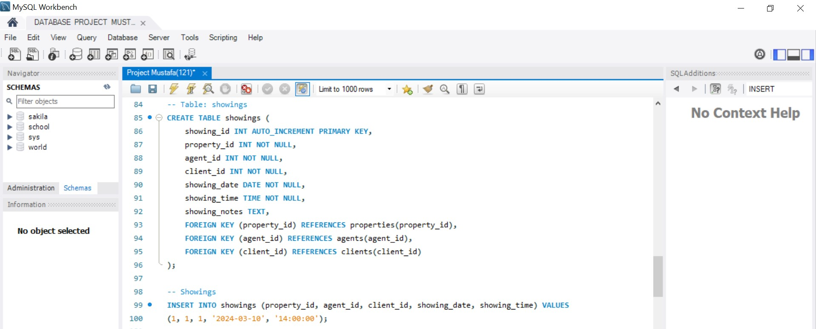

Slide 11
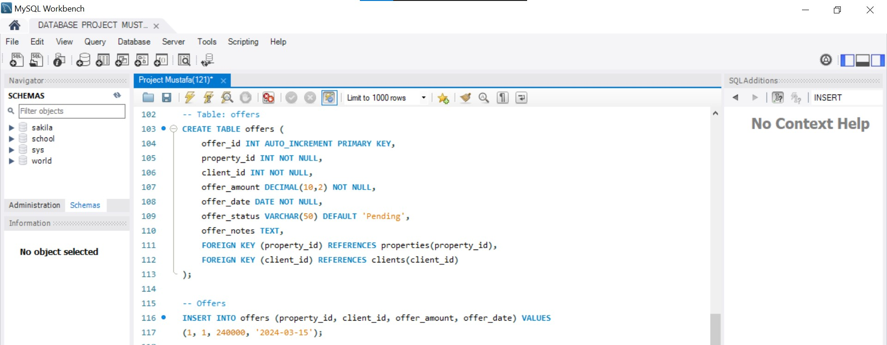

Slide 12
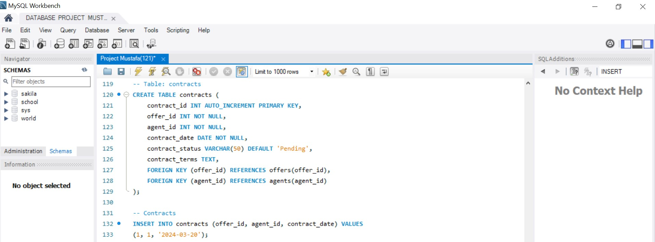

Slide 13
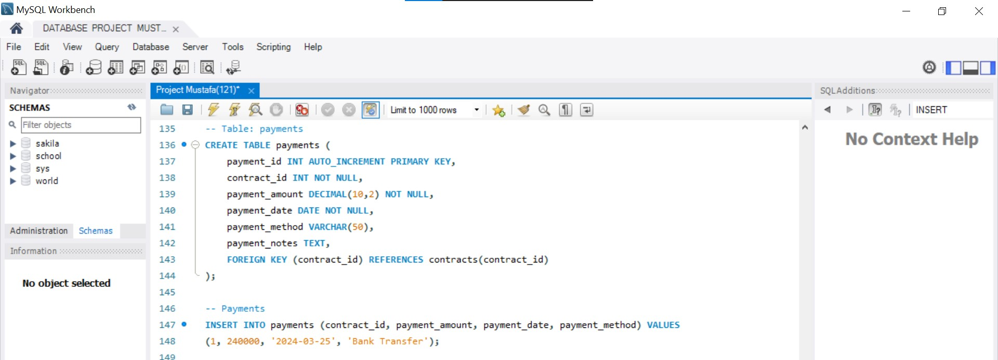

Slide 14
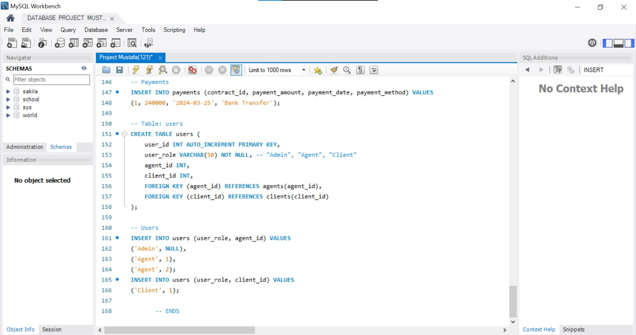

Slide 15
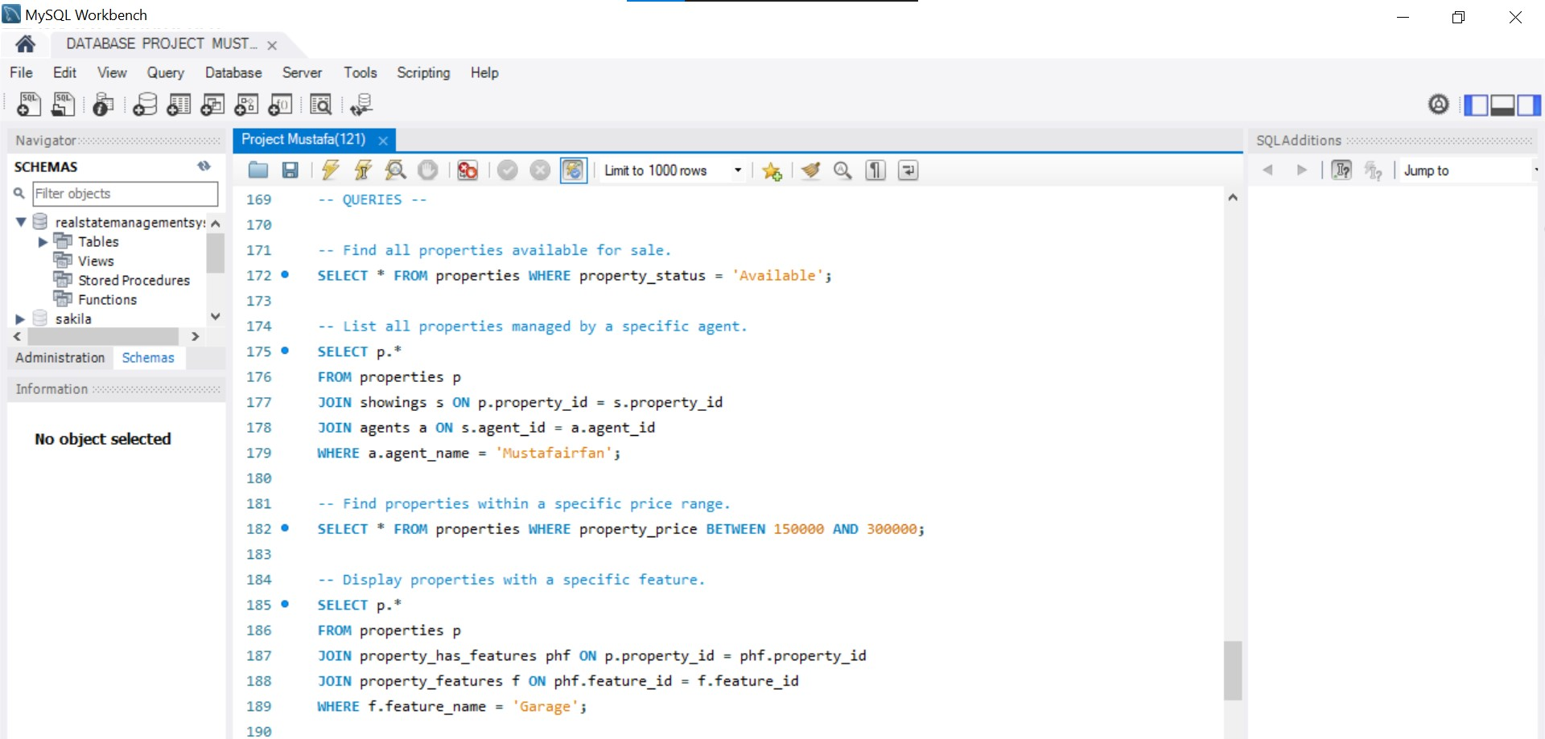
QUERIES:

Slide 16
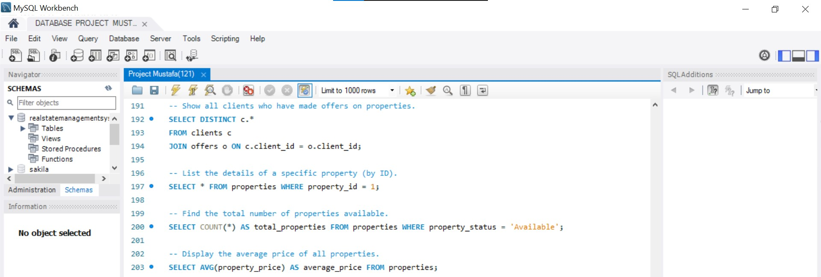

Slide 17
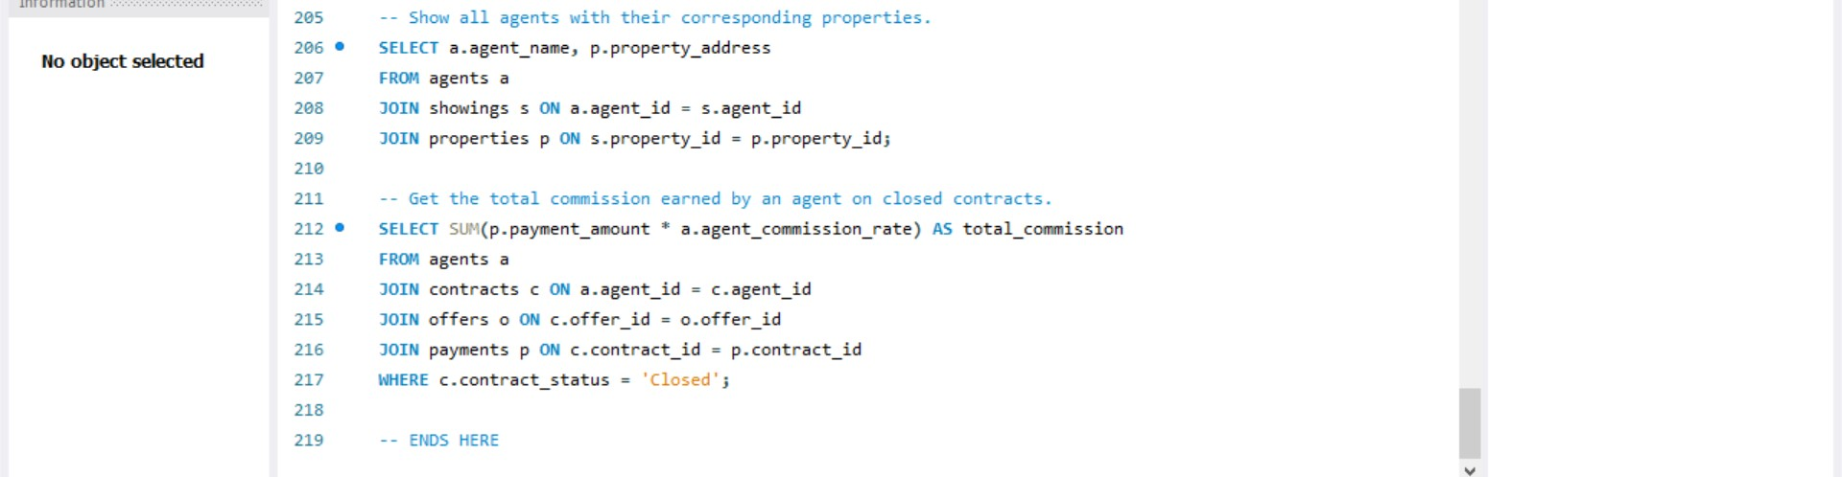

Slide 18
Thank you for joining me at my presentation.
Your time and attention are truly appreciated for me.

